Slide 1

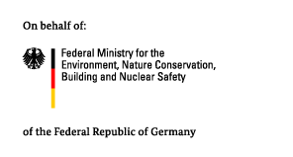



Viet Nam:
Ministry of Natural Resources and Environment of Viet Nam
Country Case
Side Event at SB50 | 21 June 2019
Department of Climate Change

Slide 2
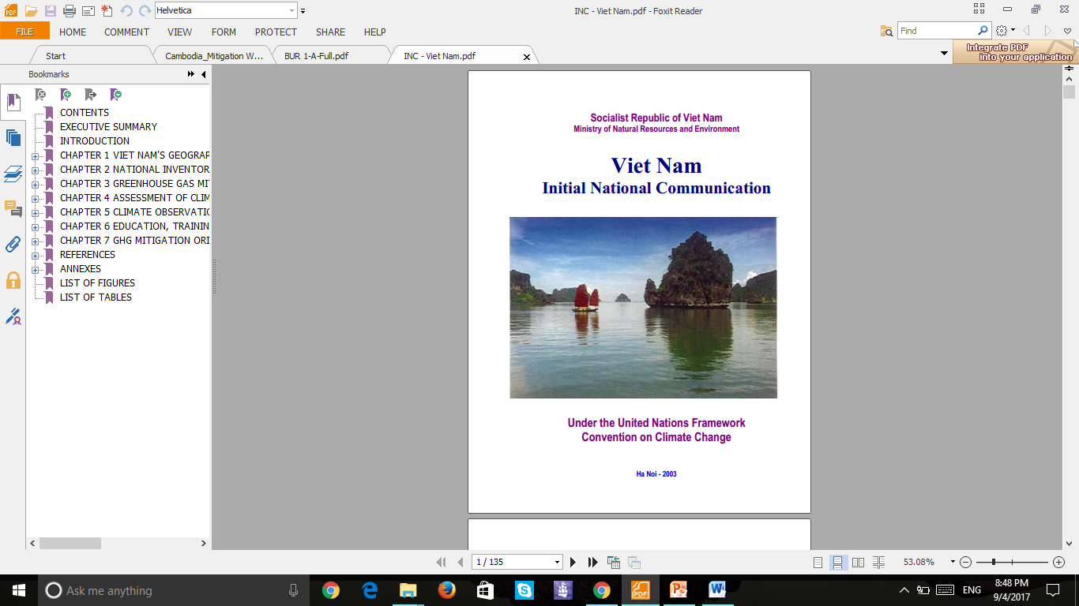
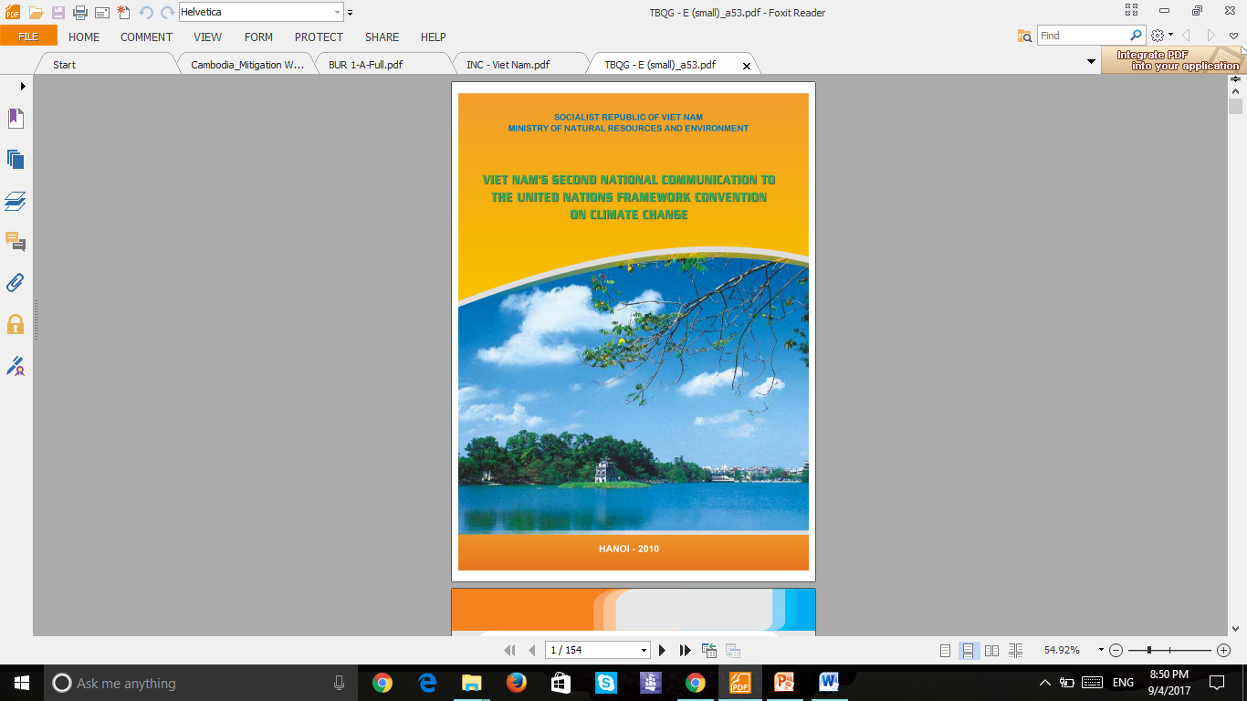

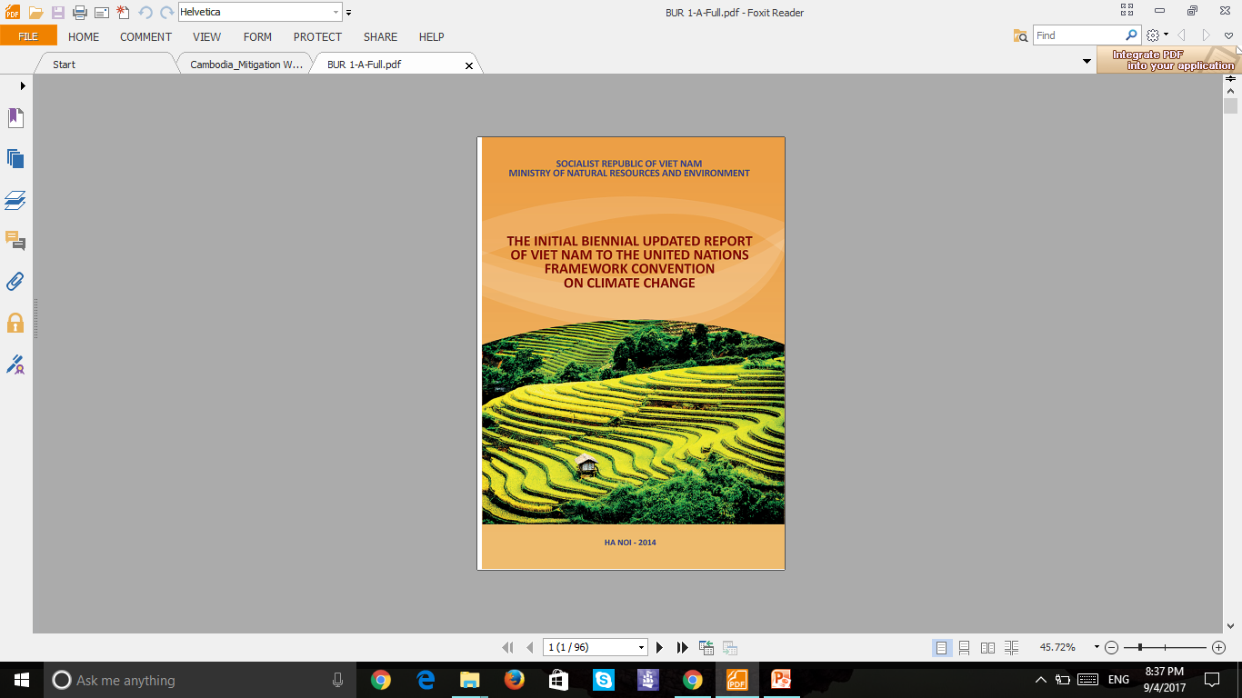
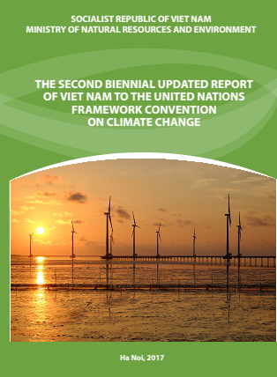
National experiences: success stories and challenges
Is a learning-by-doing process, leaded by MONRE, participated by Line Ministries, supported by various development partners
Lesson learnt and gaps identified and analysed after submitting each report and comprehensively reviewed by Information Matters project
Involvement and ownership of sectors are improving, of subnational level needs to be enhanced
NC 1 (12/2003)
NC 2 (12/2010)
NC 3 (2/2019)
BUR3
BUR 1 (12/2014)
BUR 2 (11/2017)
BUR 3
(EXPECTED 12/2020)

Slide 3
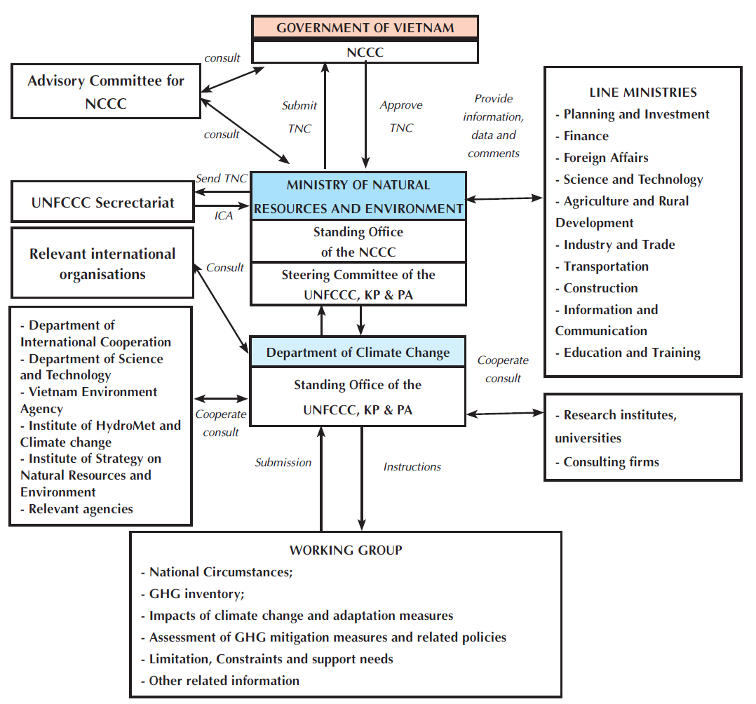
Example of engagement in preparing the 3rd NC

Slide 4
Benefits of Reporting in Viet Nam
Raised awareness on BUR, ICA process under UNFCCC and aligned international requirements with national and sectorial priorities
Supported the identification of own constrains and capacity building needs
Supported the identification of key sectors for mitigation action
Enhanced technical capacities for reporting GHG inventories, on mitigation actions and on support needed and received
Laid the foundations for the improvement of Viet Nam‘s key categories of the GHG inventory

Slide 5
Support needed to deal with ETF requirements
Legalize arrangements for GHG inventory, BTR preparation and NDC-progress tracking
Continue to build capacity and improve expertise for staff and experts involved in implementation (IPCC 2006, ICA…)
Comprehensively assess and monitor the emission level by sources to ensure completeness and double check of the GHG inventory
Improve time series and perform higher tiers for key categories
Conduct GHG emissions projections
Report transparently on NDC description and progress tracking on NDC
Verification at country/sectorial and facility levels/QA+QC

Slide 6
Ministry of Natural Resources and Environment of Viet Nam
Thank you for your attention!
Mr. Pham Van Tan
Deputy Director General
Department of Climate Change
Ministry of Natural Resources and Environment of Viet Nam
E-Mail: pvtan11@gmail.com
Website: www.monre.gov.vn
Department of Climate Change

